Slide 1

ASC Tutorial Center Database
By
Cadence Liles, Leslie Gonzalez, Sajan Thakuri, Darshan Dahal, Hamzah Kourdieh

Slide 2
Introduction
What is the problem
Hard to track sessions, attendance, and tutor information
Why is it important to support?
Accurate data improves scheduling and coordination
Supports efficient tutoring operations
What your solution will help?
Organizes people, sessions, subjects, and languages
Improves accuracy, consistency, and scalability
Non-systematic Operations of ASC

Slide 3

User Requirements
Mangers
Manage tutor records
Adjusting subjects/offerings
Review session schedules
view student attendance
Students
Tutors
Specify subjects they teach and languages they speak
View assigned sessions
Record student attendance
Register for sessions
View availability, subjects, & tutors
Set preferred language

Slide 4
Entity Relationship Diagram
Notes:
Need to explain sort of what’s happening and need to talk about business assumptions:
Tutors must be students in the system
Every session is taught by only one tutor at a time
A tutor can teach using multiple languages and teach multiple subjects
A student may register for multiple sessions
Each subject must exist before assigning tutor expertise.

Slide 5
Relational Schemas
Expertise( YearsOfExperience: int, SystemID, SubjectID)
SystemID is FK referencing Tutor.SystemID,
SubjectID is FK referencing SubjectsOffered.SubjectID
Session(SessionID: int, Date: yyyy/mm/dd, SessionTime: time, Location: string, StudLim: int, SubjectID, SystemID, LanguageID)
SubjectID is FK referencing SubjectsOffered.SubjectID,
SystemID is FK referencing Tutor.SystemID,
LanguageID is FK referencing AvailableLanguage.LanguageID
Attend ( DateReg: yyyy/mm/dd, Status: string, SystemID, SessionID)
SessionID is FK referencing Session.SessionID,
SystemID is FK Student.SystemID
AvailableLanguage ( LanguageID: int, Language: string)
Fluency( LanguageID, SystemID, Fluent: string)
LanguageID is FK referencing AvailableLanguage.LanguageID,
SystemID is FK referencing Tutor.SystemID
Person( SystemID: int, FirstName: string, LastName: string, Email: string, PhoneNum: int, UserName: string, Password: string)
Managers(DateHired: yyyy/mm/dd, SystemID)
SystemID is FK referencing Person.SystemID
Student( PreferredLanguage: string, SystemID) )
SystemID is FK referencing Person.SystemID
Tutors(DateHired: yyyy/mm/dd, ManagedBy: int, SystemID)
ManagedBy is FK referencing Manager.SystemID,
SystemID is FK referencing Student.SystemID.
SubjectsOffered(SubjectID: int, SubjectName: string, TutorCount: int (derived))

Slide 6
Generated Database Diagram

Slide 7
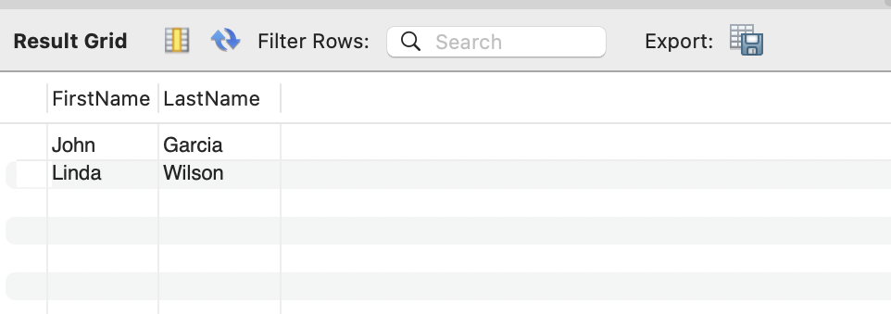
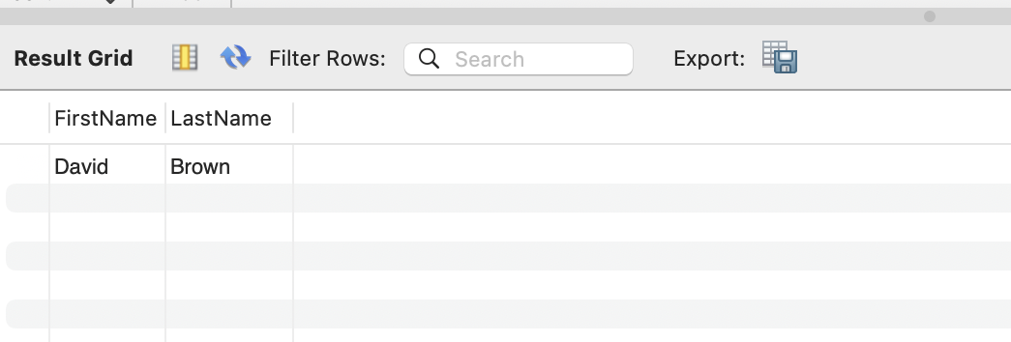
SQL Implementation Test
Test Case 2: A manger or tutor wants to check how many students are registered to attend a certain session
Code:
Select p.FirstName, p.LastName
From Attend as a
Join Person as p
on a.SystemID = p.SystemID
Where a.SessionID = 1;
Test Case 1: A manager or student wants to see all tutors who can teach in Spanish
Code:
Select p.FirstName, p.LastName
From Tutor as t
Join Fluency as f
on t.SystemID = f.SystemID
Join AvailableLanguage as l
on f.languageID = l.languageID
Join person as p
on t.systemID = p.systemID
Where l.language = 'Spanish';

Slide 8
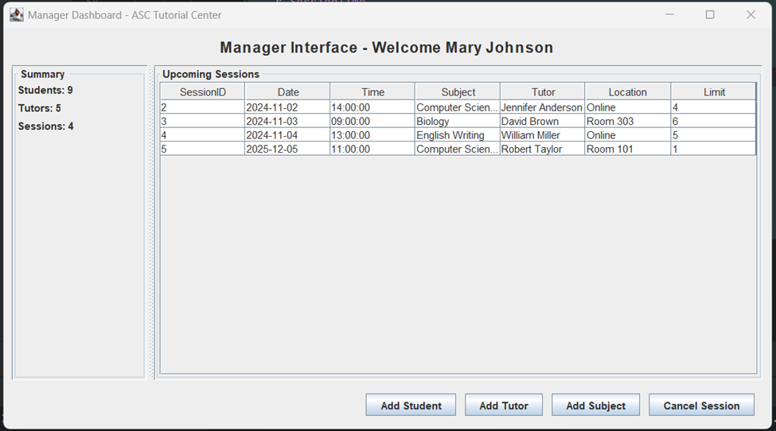
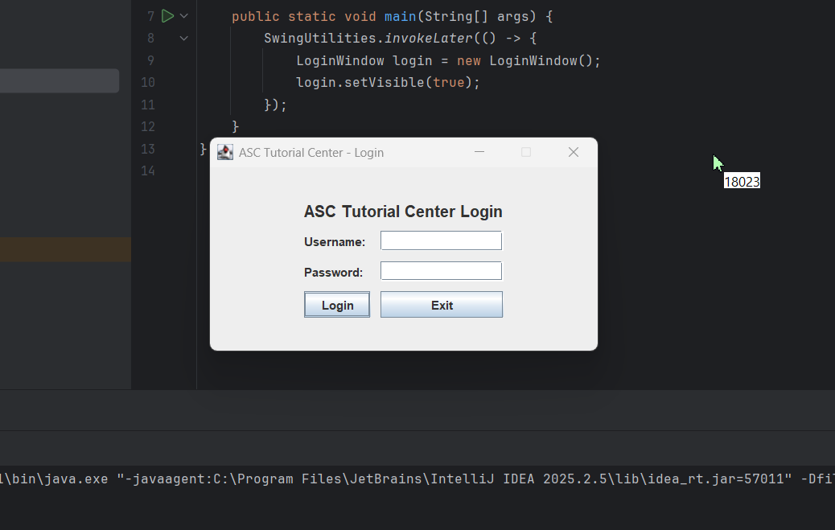
Database Application
The technologies used for the project are MySQL, IntelliJ, and jFrame)
The pictures demonstrate:
  Itellij IDE on the left
    Code opened in the editor
    A successfully launched Login GUI window
  Console output that the program is running
  Welcome Message: The interface greets the manager, Mary Johnson
    Summary Panel (Left Side):
    Students: 10 registered
    Tutors: 6 available
    Sessions: 3 upcoming tutorial sessions

Slide 9
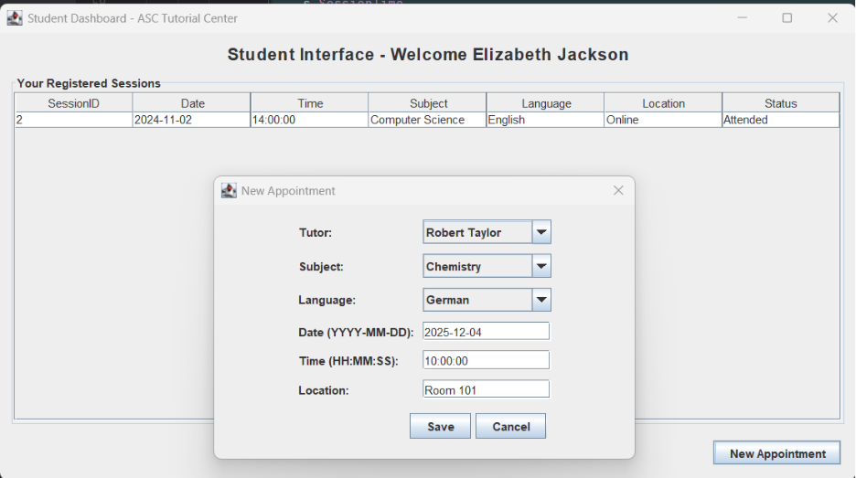
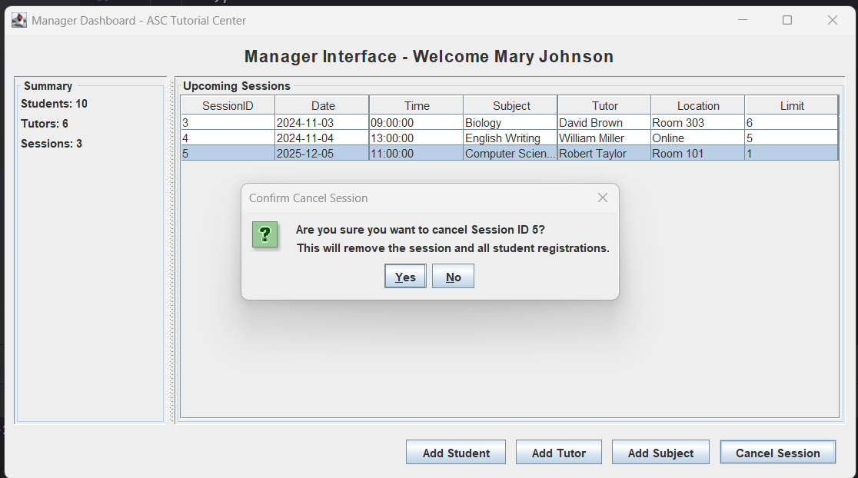
Application Test
Shows a student registering for a session
Shows a manager deleting a session

Slide 10
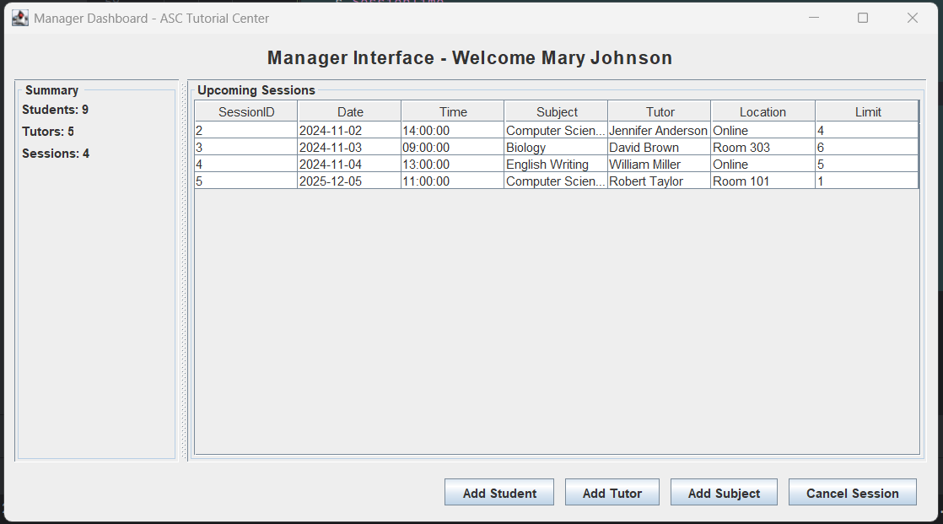
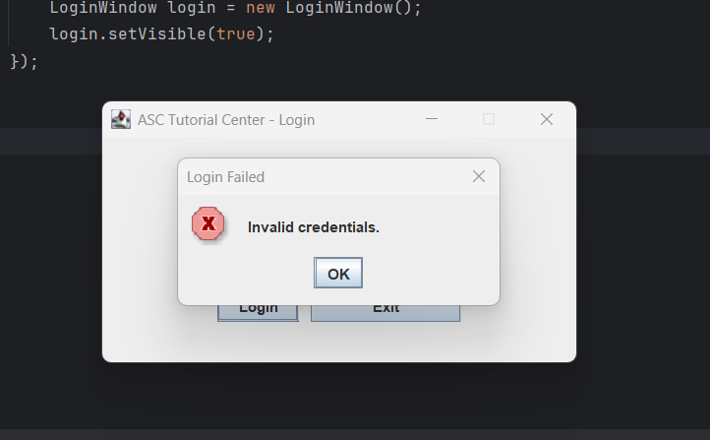
Security Concerns
  Authentication and Authorization:
    Verified role-based access so managers, tutors, and students can only access permitted features.
  SQL Injection Prevention:
    Tested malicious inputs; system precents injection through controlled input handling and predefined queries
  Password Handling:
    Current system uses simple string validation; noted need for hashed password storage.

Slide 11
Future work
Automatic session reminders for tutors and students
Reduces missed sessions
Helps both parties stay organized and on time
Full Scheduling System
Detects scheduling conflicts and prevents collusion
Ensures every student has a subject specific tutor
Improves overall session coverage and efficiency
Topic-level session details
Allows tutor to identify specific aspect of what student needs help with.
Helps tutors prepare instructional methods in advance
May require coordination with professors to upload topic lists

Slide 12
Conclusion
What we did
Designed ERD and Relational Schemas based on business need
Built and implemented MySQL tables
Created an application UI
What we learned
Convert real processes and business needs into database structures
Manage constraints, and entity relationships
Connecting the database with application, Realtime i/o operation
What we’d do differently
Explore more options for SQL DBMS which would generate better Database Diagram
Plan a better schedule to get work completed by

Slide 13
Work Distribution
Cadence Liles
  Designed ERD, created schemas from ERD, coded MySQL database, assisted in putting together final report and co-created the presentation
Leslie Gonzalez-Cisneros:
  Presentation design/development, report review, and application testing with Darshan
Darshan Dahal:
  Application part based on the schema, UI design, testing IntelliJ, report and presentation review.
Sajan Thakuri and Hamzah Kourdieh:
  Worked on professor’s feedback on schema.

